Slide 1
Academic Website Data Classification to Improve Search Results
Anitha Ganesha
Ramya Nair
Data mining(CSCI 5502) 4/1/2013

Slide 2
Data Collection
Web Crawler - Crawler4j : Open Source Java project.
Hypertext Links and textual contents are separated.
Data Sets: 1. http://www.colorado.edu/cs/ 2. http://english.colorado.edu/
1. 10GB data : 78000 documents extracted.
2. 18MB data : 2800 documents extracted.

Slide 3
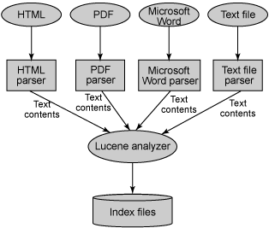
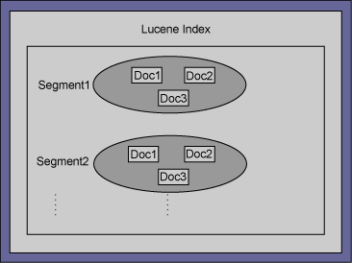
Data Preprocessing
Apache Lucene: Indexing tool.
Uses Inverted Index concept.

Slide 4
Data Clustering
Converted to feature vector using Apache Mahout lucene.vector functionality
Apache Mahout k-mean clustering technique used to create clusters
Varied input was provided for k, max iterations, and distance measure
Output in the form of cluster files and clusteredPoints

Slide 5
Results till now
Used Apache Mahout clusterdump utility for manual evaluation
Only 3 clusters formed, converges in 3-4 iterations!
Error in web-crawling – Crawler trap!
Will be further investigated

Slide 6
Future Work
Fix the Crawler Trap Issue
Rerun Clustering Techniques
Data Visualization
Run different clustering techniques and compare the results
Data Evaluation
Testing and Documentation

Slide 7
References
Han, Jiawei, Micheline Kamber, and Jian Pei. Data Mining: Concepts and Techniques.Waltham, MA: Morgan Kaufmann, 2012. Print.
https://code.google.com/p/crawler4j/
http://lucene.apache.org/core/
http://mahout.apache.org/

